Slide 1
KAKINADA INSTITUTE OF ENGINEERING &TECHNOLOGY-II
DEPARTMENT OF CSE – ARTIFICIAL INTELLIGENCE AND DATA SCIENCE
YOLO REAL TIME OBJECT DETECTION
Under the esteemed guidance of
Mr.S.SURESH
Assistant professor
PRESENTED BY :
RELLI PRAVEEN 216Q1A4585
Y.V.S.CHANDRA 216Q1A4567
N.SAI 216Q1A4584
NAGARAJU 216Q1A4582
GNANESWAR 216Q1A4591
KIET-II TEAM-17
1

Slide 2
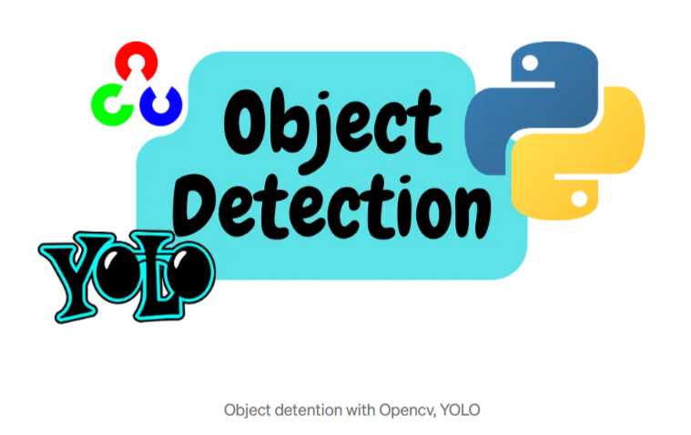
Contents:
ABSTRACT
INTRODUCTION
PURPOSE OF THE PROJECT
Related to work
methodology
SOFTWARE REQUIREMENTS
TECHNOLOGIES
ADVANTAGES
APPLICATIONS
How yolo was developed
RESULTS
FUTURE SCOPE
KIET-II TEAM-17
2

Slide 3
Abstract
Object detection is a crucial task in the field of computer vision with wide- ranging applications from surveillance to autonomous driving. This project explores the implementation of state-of-the-art object detection techniques to accurately identify and localize objects within an image or video stream. Leveraging deep learning architectures such as Convolutional Neural Networks (CNNs), specifically tailored for object detection tasks like Single Shot Multi-Box Detector (SSD) and You Only Look Once (YOLO), the project aims to achieve real-time detection performance while maintaining high accuracy. Additionally, transfer learning techniques are employed to adapt pre-trained models to specific object detection tasks, reducing the need for extensive labelled data and training time.
KIET-II TEAM-17
3

Slide 4
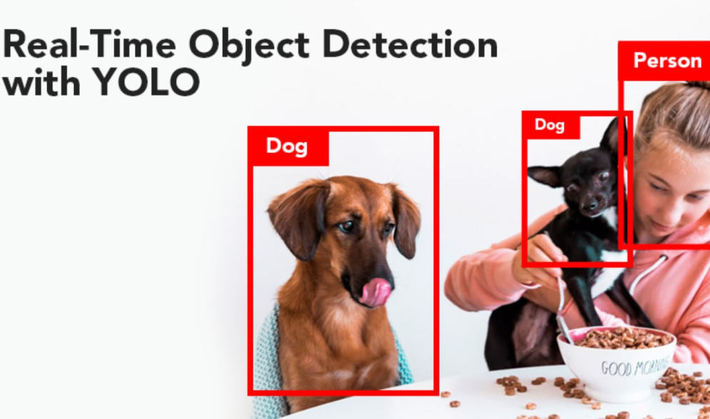
Introduction
Single-Pass Detection
Speed And Efficiency
Global Context
YOLO processes the entire image at once using a single neural network, dividing it into a grid to predict objects' bounding boxes and classifications simultaneously.
It is highly optimized for real-time detection, making it ideal for applications like autonomous vehicles, robotics, and surveillance.
YOLO considers the entire image context, which enhances accuracy and reduces false positives.
KIET-II TEAM-17
4

Slide 5
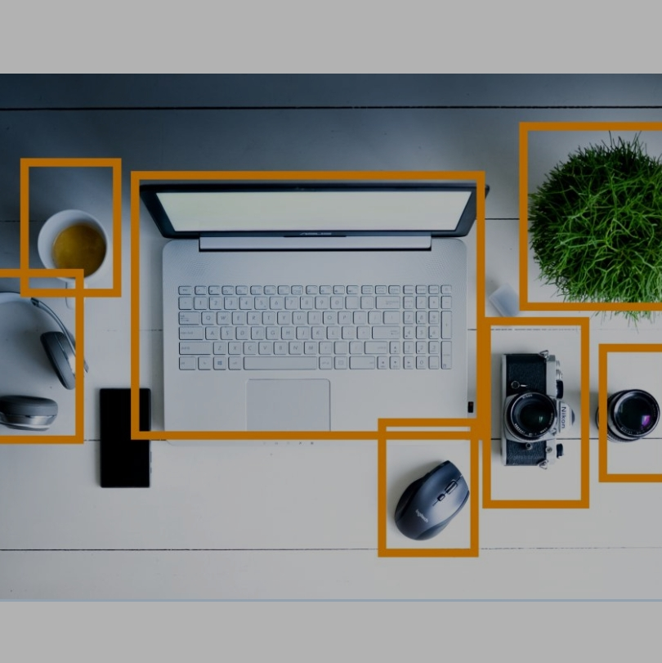
PURPOSE OF THE PROJECT:
Automation and Safety: It helps in applications like autonomous vehicles, where real-time object detection is crucial for identifying pedestrians, vehicles, and obstacles to ensure safe navigation.
Surveillance and Security: By detecting suspicious activities or unauthorized objects, this project enhances surveillance systems' effectiveness in monitoring environments.
Interactive Applications: The project aims to make advanced object detection accessible and interactive for users, enabling them to visualize results and adjust parameters with ease.
Educational and Research Contributions: It serves as a resource for those learning about or advancing research in computer vision, showcasing the implementation of state-of-the-art YOLO models.
KIET-II TEAM-17
5

Slide 6
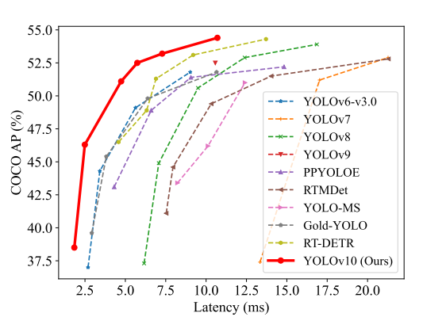
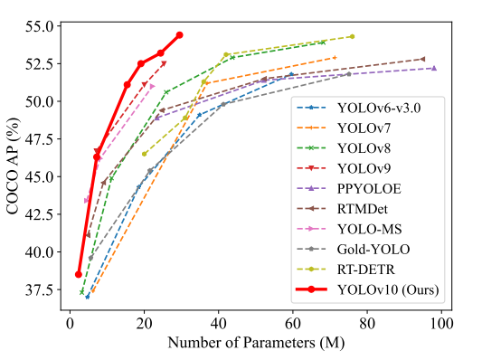
Related to work
Real Time Object Detectors:
These focus on classifying and locating objects under low latency for real-world applications. Among them, the YOLO series stands out as mainstream detectors, progressively evolving through architectures, designs like CSP Net, innovative strategies (e.g., anchor-aided training), and feature extraction techniques to enhance accuracy and efficiency across versions YOLOv1 through YOLOv9.
Freelance Earnings
Irregular and varies based on the number of clients and projects.
End-To-End Object Detectors:
This approach streamlines traditional detection pipelines, eliminating handcrafted components and post-processing. DETR introduced the transformer architecture and Hungarian loss for one-to-one prediction, inspiring several enhanced variants (e.g., Deformable-DETR, DINO, RT-DETR). Meanwhile, CNN detectors like Learnable NMS and OneNet propose similar end-to-end strategies, focusing on optimal sample selection and removing duplicate predictions.
Investment Returns
KIET-II TEAM-17
6

Slide 7
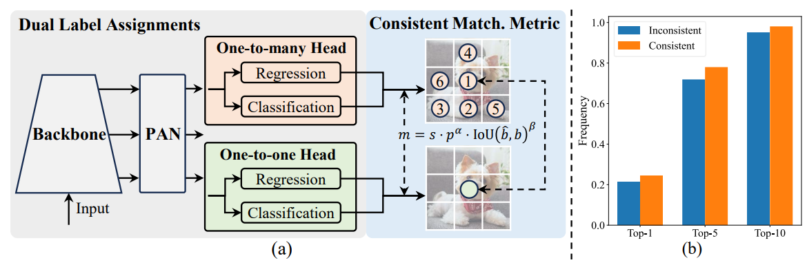
Methodology:
It mainly consist of mainly: 1.Dual Lable Assignments
2.Consistent match metric
KIET-II TEAM-17

Slide 8
Dual Label Assignments: Use both one-to-many and one-to-one label assignments during training.
NMS-Free Inference: Only the one-to-one assignment head is used at inference to eliminate the need for NMS.
Consistent Matching Metric: Apply the same matching metric (with parameters α, β) across both assignments to stabilize training.
Lightweight Classification Head: Design a simpler classification head to speed up the model without sacrificing accuracy.
Efficient Downsampling and Block Design: Enhance feature extraction using spatial-channel decoupled downsampling and optimize network blocks with rank-guided adjustments.
KIET-II TEAM-17
8

Slide 9
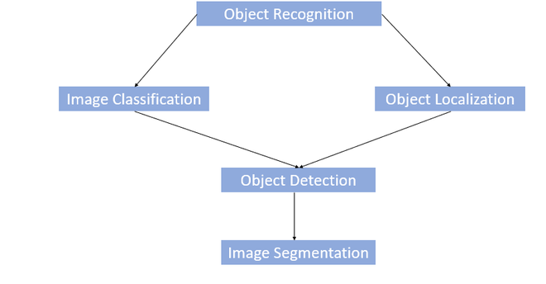
SOFTWARE REQUIREMENTS:
Programming Language
Libraries and Frameworks
Python (as it supports YOLO and computer vision libraries efficiently).
Ultralytics YOLO: For implementing YOLO object detection models.
OpenCV: For image and video processing tasks.
Gradio : To create an interactive user interface.
Tempfile : To handle temporary files while processing videos.
Development Environment
Operating System
IDEs like PyCharm, Visual Studio Code, or Jupyter Notebook for coding and debugging.
A Python environment manager, such as Anaconda or virtual env, for managing dependencies.
Our code should be compatible with Windows, macOS, or Linux operating systems.
KIET-II TEAM-17
9

Slide 10
TECHONOLOGIES:
Computer Vision: The foundation of the project, enabling machines to interpret and analyze visual data from images and videos.
Deep Learning: Leveraging YOLO (You Only Look Once), a deep learning-based algorithm designed for real-time object detection using convolutional neural networks (CNNs).
OpenCV: A powerful library for image and video processing tasks, widely used in computer vision applications.
Gradio: For creating an interactive, user-friendly interface that allows users to interact with the object detection system easily.
Python Programming Language: The central programming language for implementing the algorithm and integrating the various components.
Ultralytics Framework: Providing access to pre-trained YOLO models, streamlining the process of deploying state-of-the-art object detection systems.
.
KIET-II TEAM-17
10

Slide 11
Advantages
Real Time Efficiency
High Accuracy
Ensures quick and accurate object detection in both images and videos, making it suitable for time-sensitive applications like autonomous vehicles and surveillance.
Supports diverse use cases, ranging from anomaly detection to research in computer vision, making it valuable across industries.
Versatility
User Accessibility
YOLO's innovative approach leverages global image context, reducing false positives and providing precise object localization.
Incorporates Gradio for an intuitive interface, allowing easy interaction and customization by users.
.
KIET-II TEAM-17
11

Slide 12
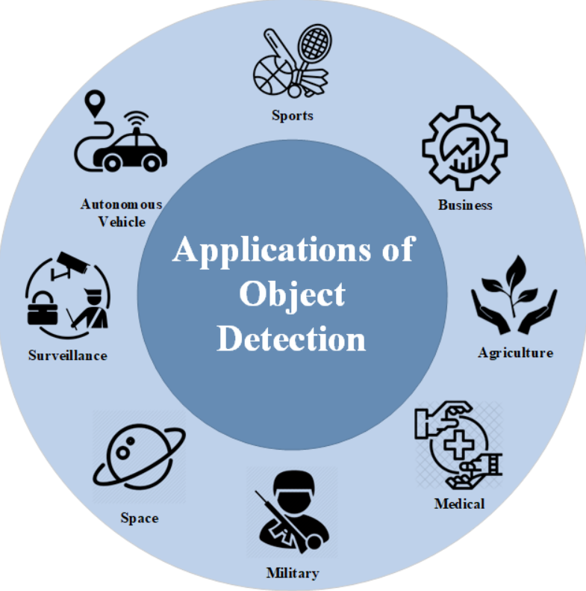
Applications:
Autonomous Systems: Enhances navigation for self-driving cars and drones by detecting obstacles, traffic signs, and pedestrians in real time.
Surveillance and Security: Improves monitoring systems by identifying unusual objects or suspicious activities in real-time video streams.
Healthcare Applications: Assists in analyzing medical images like X-rays or CT scans, enabling rapid and accurate detection of anomalies.
Agricultural Insights: Identifies crop diseases, pests, or monitors farmland health using drone-based object detection.
Retail and Robotics: Supports inventory tracking in retail and enables robots to recognize objects for better task execution.
KIET-II TEAM-17
12

Slide 13
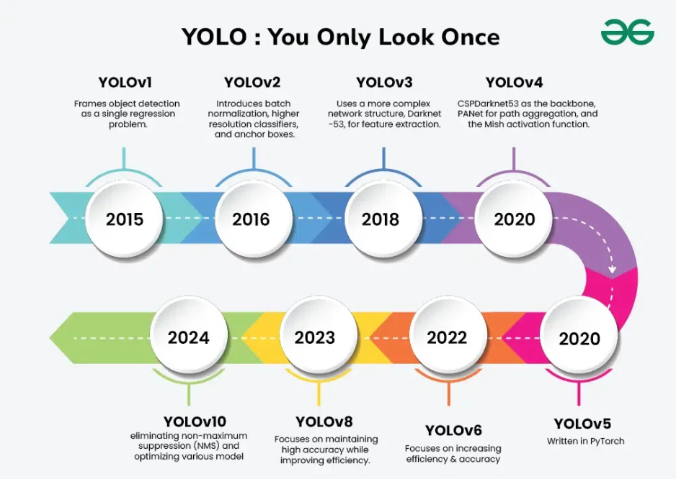
How Yolo was evolved
KIET-II TEAM-17
13

Slide 14
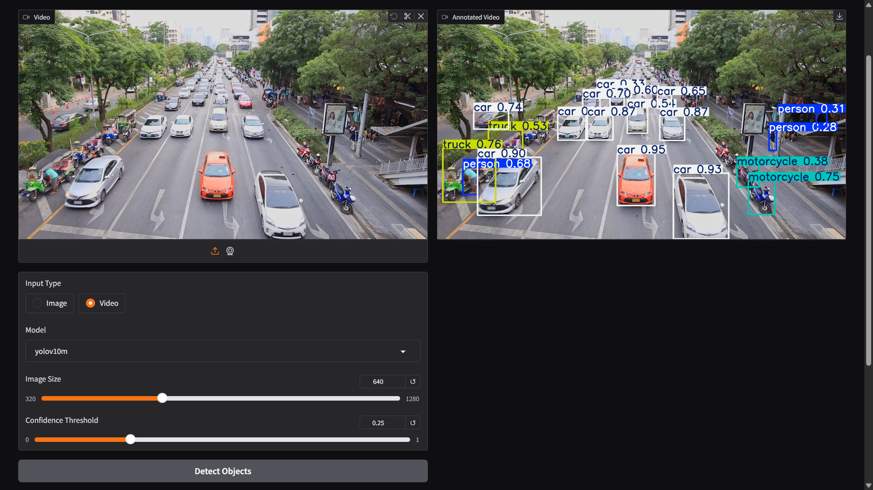
OUTPUT:
KIET-II TEAM-17
14

Slide 15
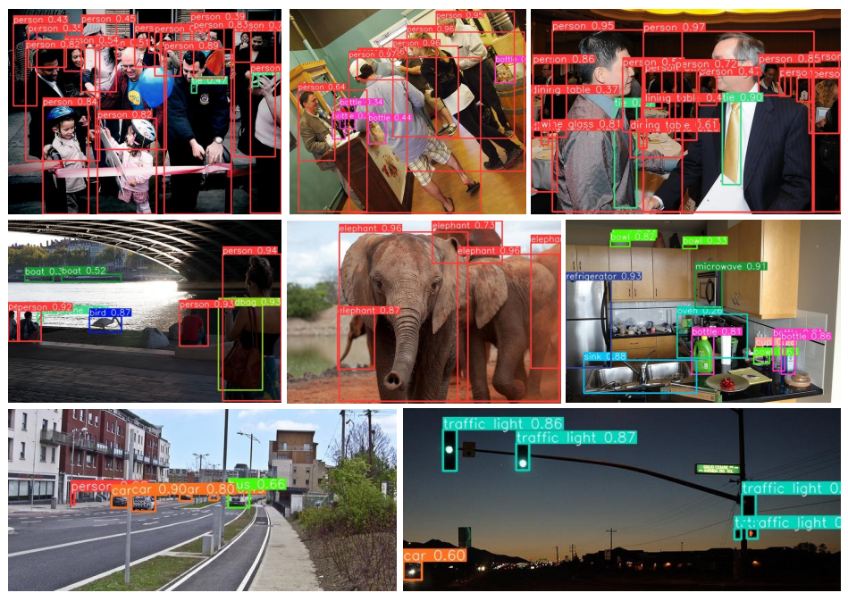
Visualization results under complex and challenging scenarios.
KIET-II TEAM-17
15

Slide 16
FEATURE SCOPE
YOLOv10 Inference (Image + Video Support):
Model Selection:
Dynamic Input Type Switch:
Adjustable Parameters:
Perform prediction either on single images or videos.
Automatically annotate results (draw bounding boxes).
Dropdown to select between different YOLOv10 model sizes: yolov10n, yolov10s, yolov10m, yolov10b, yolov10l, yolov10x.
User can switch between "Image" and "Video" input.
UI dynamically shows/hides fields depending on input type.
Image Size: User can set input size (320 - 1280, step 32).
Confidence Threshold: User sets detection confidence (0.0 - 1.0).
Video Frame Skipping (for speed):
Interface:
Public Link Generation:
Outputs:
Built with Gradio Blocks API.
Clean two-column layout:
Left side → Input controls (Image, Video, Model, Parameters, Button).
Right side → Output displays (Annotated Image or Annotated Video).
Processes every 3rd frame (frame skipping logic) to optimize inference time.
share=True enables a public URL for easy sharing.
If input is an image: show annotated image.
If input is a video: show annotated video.
KIET-II TEAN-17
16

Slide 17

Q & A
FEEL FREE TO ASK YOUR DOUBTS............
KIET-II TEAM-17
17

Slide 18
Thank You

